Slide 1
English II Summer Reading Assignment
2020 - 2021

Slide 2
Summer Reading Assignment
Pick a book to read from the Florida Teens Read 2020 – 2021 List
Complete an assignment choice to answer the question: Why this book? (or Why NOT this book?)
Start the book. If you don’t like it, pick another one!

Slide 3
Purpose
Your task is to READ. First and foremost, read and then read and then read some more. Research shows that the more you read, the better your vocabulary, your writing, your fluency, your comprehension.
We want you to READ.
If you start a book and don’t like it, pick another!
With an end in mind…to answer the question:
Why this book? Why not this book?
Remember, you can even do this with a book that you didn’t like, and maybe didn’t even finish.

Slide 4
Project Choices Pick one of the following to complete for your novel choice
Reading Log
See slides 5 & 6
“Twitter Page”
See slides 7 - 11
Lit Chat
See slides 12 - 17
“Snap Streak”
See slides 18 & 19
“Movie Trailer”
See slides 20 - 23

Slide 5
Choice 1: Reading Log
If you choose, to do a reading log, you will keep track of each time that you sit down to read. As you do so, fill out each column of the log.
Make sure to fill out the information at the top of the form with your name, the book title, the author, and the total number of pages.
Keep track of the date and time that you read. The page numbers you read (not how many pages, which pages you read), a brief summary of three to five sentences, and a parent signature.
When you finish reading, consider why you liked the book (or why you did not). Answer the questions in the last row of the chart.
The log should be PRINTED and completed in pen/pencil. You will submit pictures of it if needed.

Slide 6
How to Complete the Reading Log
Don’t forget to include the book information!
Log each time you read
Get a parent signature EVERY time
Write a summary of the part that you read. This should be about three to five sentences.
Keep track of which pages you read

Slide 7
Choice 2: “Twitter Page”
As you are reading your summer reading book, you have different choices for doing a project to show your understanding of the book you are reading.
One of those options is a Twitter conversation between yourself and a character or two or three different characters in the book.

Slide 8
Requirements
You will need to have at least 5 tweets a piece between two characters, slightly less if there are more than 2 characters making comments.
You will need to show a total of three conversations through the course of the book.
These should be done at different points in the book and may be done between different characters each time.
You will create your conversation on a word document, paper or other method of recording the conversation.

Slide 9
Specifications
An example of you and a character having a conversation may be that a character asks a question out into the universe and you give them advice, you and character will exchange 5 tweets each about the situation and the advice. You give them.
Another option is that several characters gather online to talk about what is going on in the story at a specific point. Each character will interact, and they will discuss what is going on in the story and you will use your knowledge of the characters to craft their responses.
Examples of such conversations are on slide 11. These conversations are based on characters from Pride and Prejudice.
You will need to have a more in depth conversation than “Hey, what’s good” “nothing” “have you seen __ character’s name around?”

Slide 10
Considerations
Your tweets should include plot points and important moments that the characters may want to discuss, come back to, or understand better.
They can include status updates that another character comments on.
Conversations can be between just two characters
Status updates should have comments from other characters major and minor
Characters can ask for advice from students or other characters.
Include minor characters’ comments for a unique perspective.

Slide 11
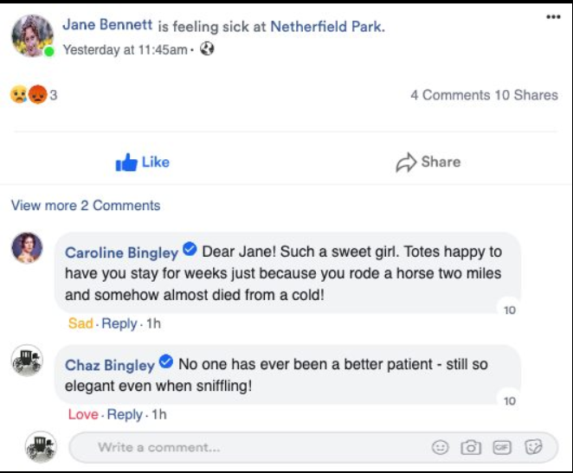
Examples

Slide 12
Choice 3: Lit Chat
Why this book? Why not this book?
After reading your book, you “have” a chat with a friend, which is to say you write a chat that answer one of the above questions. Another option is to write a chat between two characters. Either way you write it, the idea is that you reveal what you either did or did not like about the book.
Keeping your answer to the question in mind, your task is to produce a “Lit Chat” conversation that mirrors a Snap Chat conversation.

Slide 13
Requirements
You should have at least 3 “snaps” with all of the information outlined in the slides that follow.
You may produce this using PowerPoint, Word, Google Slides…any way you want in order to make this as similar to a Snap Chat conversation as you can, answering “Why This Book” or “Why Not This Book.”
Do you need to include cited examples from the book you read? Yes…show that you read the book. Show what you did or did not enjoy about the book. Show what stuck with you.
Remember, you can even do this with a book that you didn’t like, and maybe didn’t even finish.
You can use the template as it is provided or use another means to create your “Lit Chat” about your book. Happy creating!

Slide 14
SAMPLE
Snapchat Project
Picture representing the book
Central Idea of Project
“It’s a sin to kill a Mockingbird.”

Slide 15
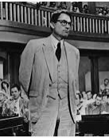
Post: What is the picture representing
Post: The Courtroom Scene (day one)
Perspective: The court reporter
Date (Approx): 1932
SAMPLE
Who took the photo
Date of the photo
Comments
Court Reporter: Atticus Finch – quite a man. I wonder if someone reading this might be able to see that history repeats itself if we aren’t careful.
Mayella Ewell: I don’t think so. Atticus Finch has a twisted view of how things are supposed to be. And repeating itself? What does that even mean? Nothing is ever going to change…and that’s the truth. He’s representing Tom Robinson of all people!
Court Reporter: Oh come on, are you completely blind? We are already repeating history. Tom Robinson is a good, decent man.You’re crazy, honestly.
Conversation between characters or between you and someone else about the book
“Snap” that starts the conversation
This man has the miraculous ability to turn complex debates into common talk. How strange!

Slide 16
Post:
Perspective:
Date (Approx):
Comments
Notes:
Template

Slide 17
Why This Book?
Why Not This Book?
Your final statement of
“Why This Book”
or
“Why Not This Book”
with a careful summary
of your opinion.
Notes:
Template

Slide 18
Choice 4: “Snap Streak”
Both people have to ‘send’ a pic with text at least once a day (24hrs).
‘Streak’ must last 15 days minimum. (30 posts total).
Must use at least two emojis.
Text must be short (no more than the max for SnapChat) but related to the text/characters/plot/theme.
‘Streak’ must show that you read and understood the text.
You can choose to have two characters chat or you and another student chat.
Create your ‘Streak’ in a Word document, PowerPoint Presentation, or PDF.
Include a response to the “Why this book? Why not this book?” question.
This can be in the streak or as a separate slide or paragraph.

Slide 19
Specifications

Slide 20
Choice 5: Movie Trailer
After reading your book, imagine your book is turned into a movie. Create a movie trailer to promote your book/movie answering the questions, “Why this book? Why not this book?”
Develop a movie trailer for the upcoming theatrical release keeping the question above in mind. To allow others a chance to decide if they, too, should see the movie or read the book you chose, you will produce a movie trailer for the book. You will need to provide some background information about the time period in which your book is written as well as the setting. You should use the setting, places, and time period the author of your book uses in the text to develop the book’s movie trailer.

Slide 21
Considerations
In other words, you will maintain the same plot, characters and (especially) themes, including the setting, language and style used by the author. Think about a few movie trailers you have seen for movies you then chose to see at the theatre. You can also review examples of movie trailers on the weebly site for this summer reading assignment.
Remember, the trailer will give just enough information go get you to want to go see it, or in this case, read the book, but will NOT give away the ending (NO SPOILERS). It should also answer the main topic “Why this book? Why not this book?”

Slide 22
Requirements
Video must last one to two minutes.
Video must be edited and have clear audio.
Production must clearly develop the book’s theme.
Must indicate the title and author of the book as well as indicate your name.
Must be in mp4 format OR provide a link to web-hosted site.
Answers the question “Why this book? Why not this book?”.

Slide 23
Sample Book Movie Trailers
The Bone Houses: https://bit.ly/2zwnt7B
10 Blind Dates: https://bit.ly/3fPvCom

Slide 24
Questions?
The following English II teachers are available to answer questions by email.
Please include your full name and grade when sending emails.
Ms. Holman: holmanm@pcsb.org
Mrs. Weiner: weinere@pcsb.org
Ms. Bayes: bayesk@pcsb.org

Slide 25
We hope you Enjoy your reading!

