Slide 1
Lit Chat
Why this book? Why not this book?
After reading your book, you “have” a chat with a friend, which is to say you write a chat that answer one of the above questions. Another option is to write a chat between two characters. Either way you write it, the idea is that you reveal what you either did or did not like about the book.
Keeping your answer to the question in mind, your task is to produce a “Lit Chat” conversation that mirrors a Snap Chat conversation.

Slide 2
Requirements
You should have at least 3 “snaps” with all of the information outlined in the slides that follow.
You may produce this using PowerPoint, Word, Google Slides…any way you want in order to make this as similar to a Snap Chat conversation as you can, answering “Why This Book” or “Why Not This Book.”
Do you need to include cited examples from the book you read? Yes…show that you read the book. Show what you did or did not enjoy about the book. Show what stuck with you.
Remember, you can even do this with a book that you didn’t like, and maybe didn’t even finish.
You can use the template as it is provided or use another means to create your “Lit Chat” about your book. Happy creating!

Slide 3
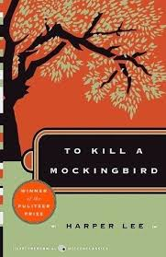
SAMPLE
Snapchat Project
Picture representing the book
Central Idea of Project
“It’s a sin to kill a Mockingbird.”

Slide 4
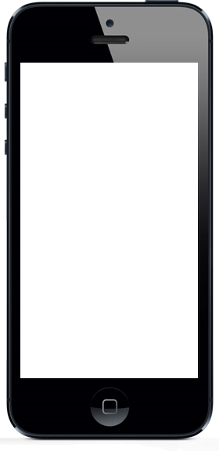
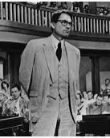
Post: The Courtroom Scene (day one)
Perspective: The court reporter
Date (Approx): 1932
Post: What is the picture representing
SAMPLE
Who took the photo
Date of the photo
Comments
Court Reporter: Atticus Finch – quite a man. I wonder if someone reading this might be able to see that history repeats itself if we aren’t careful.
Mayella Ewell: I don’t think so. Atticus Finch has a twisted view of how things are supposed to be. And repeating itself? What does that even mean? Nothing is ever going to change…and that’s the truth. He’s representing Tom Robinson of all people!
Court Reporter: Oh come on, are you completely blind? We are already repeating history. Tom Robinson is a good, decent man.You’re crazy, honestly.
Conversation between characters or between you and someone else about the book
“Snap” that starts the conversation
This man has the miraculous ability to turn complex debates into common talk. How strange!

Slide 5
Post:
Perspective:
Date (Approx):
Comments
Comments
Notes:
Template

Slide 6
Post:
Perspective:
Date (Approx):
Comments
Comments
Notes:
Template

Slide 7
Post: Election
Perspective:
Date (approx):
Comments
Comments
!
Notes:
Template

Slide 8
Post:
Perspective:
Date (Approx):
Comments
Comments
Notes:
Template

Slide 9
Post:
Perspective:
Date (Approx):
Comments
Comments

Slide 10
Why This Book?
Why Not This Book?
Your final statement of
“Why This Book”
or
“Why Not This Book”
with a careful summary
of your opinion.

